Slide 1
Database System

Slide 2
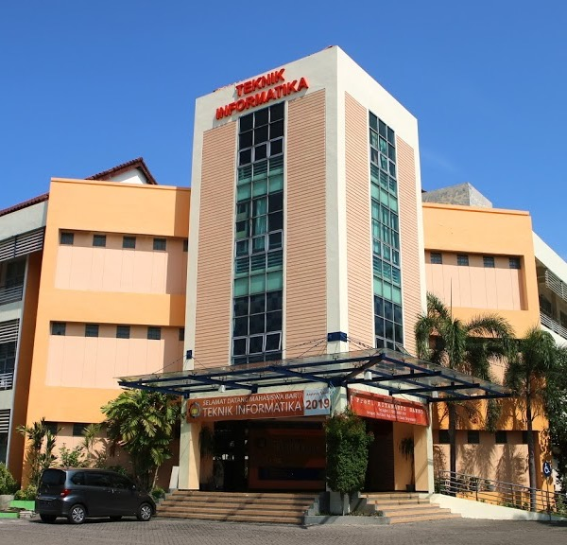
Data Manipulation Language (DML)
Data Manipulation Language

Slide 3
Outline
Data Manipulation Language
SQL-SELECT

Slide 4
Lecture Objectives
Students understand the use of DML and its kinds
Students are able to apply INSERT, UPDATE, DELETE operations
Students are able to apply SQL SELECT operation

Slide 5
Data Manipulation Language
DML (Data Manipulation Language ) → SQL language used to manipulate data in a table.
DML commands include:
INSERT – Insert/add new data into a table in the database
UPDATE – Updating data in tables in database
DELETE – Deleting data from tables in database
SELECT – Extract/display data from tables in database

Slide 6
INSERT, UPDATE and DELETE

Slide 7
INSERT
Used to ADD new data
Syntax:
INSERT INTO table_name [column_1,…,column_n]
VALUES (value_column_1_,…,value_column_n)
If data is entered into all columns (fields) of a table, then there is no need to mention the name of the column, but the entries must be in sequential order
If data is entered into a certain column (field), the column name must be stated.

Slide 8
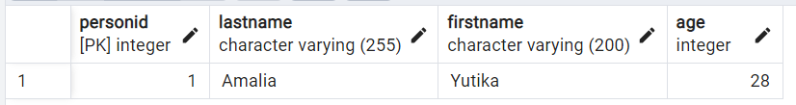
INSERT EXAMPLE(1/2)
There is a “Customer” table :
If a new data is added in Customer table, then we can use this syntax:
INSERT INTO CUSTOMER VALUES (1, 'Amalia','Yutika',28);

Slide 9
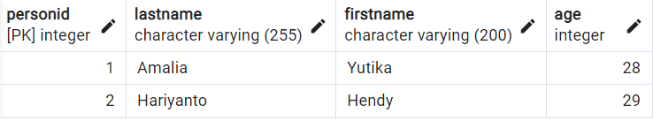
INSERT EXAMPLE(2/2)
INSERT INTO CUSTOMER VALUES (2, 'Hariyanto','Hendy',29);

Slide 10
UPDATE
Used to change or update data
Syntax:
UPDATE table_name SET column_name = value
[WHERE condition]
Table_Name contains the name of the table where the data to be changed is located.
Column_Name contains the name of the column where the column of data is located.
Value is the replacement data value to be entered
(Optional) Condition is the condition of the data to be changed.

Slide 11
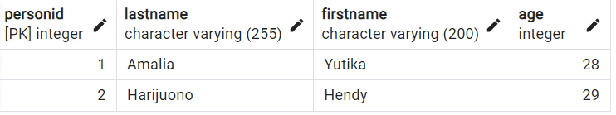
UPDATE EXAMPLE
UPDATE CUSTOMER SET LASTNAME = 'Harijuono' WHERE FIRSTNAME = 'Hendy';

Slide 12
DELETE
Used to delete data
Syntax:
DELETE FROM table_name
[WHERE condition]
Table_name contains the name of the table where the data to be deleted is located.
Condition is the condition of the data to be changed.

Slide 13
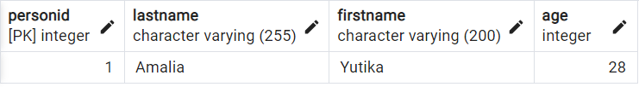
DELETE EXAMPLE
DELETE FROM CUSTOMER WHERE AGE = 29;

Slide 14
SQL SELECT

Slide 15
SQL SELECT
SELECT [DISTINCT] select_list
FROM table_source
[WHERE search_condition]
[GROUP BY group_by_expression]
[HAVING search_condition]
[ORDER BY order_expression [ASC | DESC] ]

Slide 16
SELECT statement
The SELECT statement is used to select (select) data from one or more tables.
The tabulated results are stored in the results table (referred to as the result-set).
Syntax :
SELECT column_name(s) FROM table_name
SELECT [*] [<kolom1>, <kolom2>, . . ., <kolomN>]
[<alias.column1>, < alias.column2>, . . . , < alias.columnN>]
FROM <table_name>

Slide 17
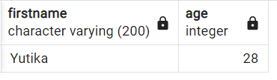
SELECT Example
Q : Get Information of First Name and Ages based on Person Table
A :
SELECT FIRSTNAME, AGE FROM CUSTOMER;
Result:

Slide 18
WHERE clause
WHERE is used to filter data so that it only displays data according to certain criteria.
Syntax:
SELECT column
FROM table
WHERE <criteria>
If <criteria> more than 1, then it can be added with AND or OR (as needed)

Slide 19
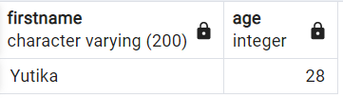
Example of using WHERE Clause
Q: Get Information of First Name of Person who are less than 29 years old.
A:
SELECT FIRSTNAME, AGE
FROM CUSTOMER
WHERE AGE < 29;
Result

Slide 20
WHERE Clause for Data Filter
Where to filter or search data in SQL Server can be in the form of expressions, namely:
comparison operation
pattern approach operation
comparison operation with a set of values

Slide 21
Operators in WHERE Clause
The operators that can be used in the WHERE clause are:
Operator | Description
= | Equal
<> | Not equal
> | Greater than
< | Less than
>= | Greater than or equal
<= | Less than or equal
BETWEEN | Between an inclusive range
LIKE | Search for a pattern

Slide 22
Example of Comparison Operation
get male employees:
SELECT * FROM Employee WHERE Sex=‘M’
get employees whose year of birth is more than 1965:
SELECT * FROM Employee
WHERE year(Bdate) > 1965
get female employees born in June:
SELECT * FROM Employee WHERE Sex=‘F’ AND month(Bdate)=6
Get Collections that have not been returned (Return Date not filled in):
SELECT * FROM Collection WHERE ReturnDate IS NULL

Slide 23
LIKE (Pattern Comparing)
This operation, only for comparison of values of type string
Used to identify strings that have a certain pattern.
In this operation, the following symbols are used:
symbol % means representing 0 to infinity of any character
symbol _ means represents 1 any character

Slide 24
Example of LIKE (Pattern Comparing)
Show employees whose addresses have the word "Houston"
SELECT * FROM Employee
WHERE Address LIKE ‘%Houston%’
Show employees whose second letter of name is “m”
SELECT SSN, Fname FROM Employee
WHERE FName LIKE ‘_m%’

Slide 25
Example of Another Pattern Comparing
Show employees whose eleventh letter of address is “g”
SELECT * FROM Employee
WHERE substr(Address,11,1)=‘g’

Slide 26
IN or NOT IN (1/3)
This expression is used to compare with a set of values
The set of values can be:
entered values
single query (queries whose results contain only one column)

Slide 27
IN or NOT IN (2/3)
The values that are filled in, meaning that we ourselves fill these values in our query.
Example:
Shows person who have ID 2 or 3
SELECT *
FROM PERSONS
WHERE PersonID IN (2,3);

Slide 28
IN or NOT IN (3/3)
Single query, i.e. the values used as comparisons are taken from a single query whose results are only one column
Example
Show data of persons who are not 27 or 29 years old
SELECT * FROM PERSONS
WHERE Age NOT IN (27,29);
Show data of persons who do not have Age data
SELECT * FROM PERSONS
WHERE Age IS NULL;

Slide 29
Aggregation Functions (1/2)
A query that involves a function counting all rows of data.
These functions are:
- COUNT(*) → get the number of rows - SUM(kolom) → get column sum result - MAX(kolom) → get the highest score - MIN(kolom) → get the lowest score - AVG(kolom) → get the average score

Slide 30
Aggregation Functions (2/2)
SELECT AVG(price)
FROM book
WHERE id_Category =1
Show the average price of a book with id_Category=1
Show number of students
SELECT COUNT(*)
FROM student

Slide 31
GROUP BY dan HAVING
Syntaxs
SELECT [DISTINCT] target-list
FROM relation-list
WHERE qualification
GROUP BY grouping-list
[HAVING group-qualification]
The GROUP BY clause is used for grouping of aggregation functions
The HAVING clause is used for filtering related to aggregation functions (count, sum, min, max, avg)

Slide 32
Example of GROUP BY
Get the average VCD price per category
✓
SELECT VCDCategory, AVG (V.RentalPrice)
FROM VCD
GROUP BY VCDCategory
SELECT V.VCDCategory, AVG (V.RentalPrice)
FROM VCD V

Slide 33
Example of using the HAVING clause
If for ordinary query filters we use the where clause, then the having clause is used to filter aggregate functions.
Example
Displays lecturers whose number of guardian children is less than 10
SELECT lecturerName, COUNT(*) as noGuardianChild FROM lecturer JOIN student ON (IDLecturer=IDStudent) GROUP BY lecturerName HAVING COUNT(*)<10

Slide 34
ORDER BY clause
used to sort query results
ORDER BY <column> ASC (=ascending): sorting from small to large, from A to Z
ORDER BY < column > DESC (=Descending): sorting from large to small, from Z to A
Example: Show employee salaries in order of largest
SELECT SSN, FName, Salary
FROM Employee
ORDER BY salary DESC;

Slide 35
JOIN Clause <table>
If we retrieve information from more than one table, then we need to combine the two tables with the JOIN <table> clause in the FROM clause.
Syntax:
FROM <table1> JOIN <table2> ON (<joinCondition>)

Slide 36
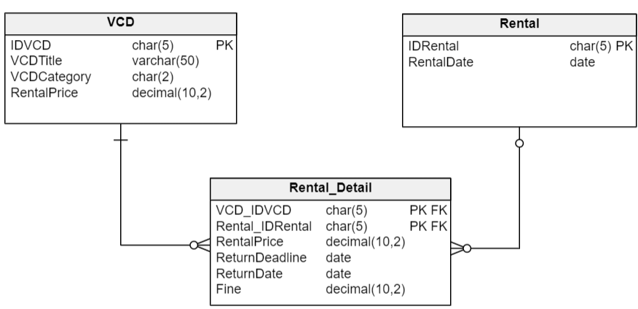
Example of JOIN
Question: Displays VCDTitle, VCDCategory, ReturnDate
VCD_Title and VCD Category can be retrieved from the VCD table, but the return_date does not exist in the VCD table, so it must be retrieved from the Details_Rental table. The two tables are related to Kode_VCD. So the query:
SELECT VCDTitle, VCDCategory, ReturnDate
FROM VCD JOIN Rental_Detail ON (VCD.IDVCD = Rental_Detail.VCD_IDVCD)

Slide 37
If there is the same column name
If there is the same field name from the included tables, then before the field name, give the table name followed by a dot (.)
For example, for the previous query with the addition of displaying the VCD Code:
SELECT VCD.IDVCD, VCD.VCDTitle, VCD.VCDCategory, Rental_Detail.ReturnDate
FROM VCD JOIN Rental_Detail ON (VCD.IDVCD = Rental_Detail.VCD_IDVCD)
Or to shorten the query using alias
SELECT V.IDVCD, V.VCDTitle, V.VCDCategory, R.ReturnDate
FROM VCD V JOIN Rental_Detail R ON (V.IDVCD = R.VCD_IDVCD)

Slide 38
Example JOIN 2
Show VCD Code, VCD_Title, MustReturn Date for VCDs with the “cartoon” category sorted by VCD Title
SELECT V.IDVCD, V.VCDTitle, V.VCDCategory, R.ReturnDate
FROM VCD V JOIN Rental_Detail R ON (V.IDVCD = R.VCD_IDVCD)
WHERE V.VCDCategory = ‘cartoon’
ORDER BY V.IDVCD

Slide 39

- THANK YOU -

